Slide 1
Software Quality Metrics Static Analysis
I4SWT

Slide 2
The Agile Testing Quadrants
Business Facing
Automated/Manual
Manual
Functional Test
Story Test
Prototypes
Simulations
Q2
Exploratory Testing
Usability Testing
User Acceptance testing
Q3
Supporting the Team
Reviewing (critiquing) the Product
Q1
Unit Test
Component Test
Integration Test
Q4
Performance/Load Testing
Security Testing
Non-functional Req. Testing
Software Quality Metrics
Automated
Tools
Technology Facing
Ref: Crispin & Gregory: Agile Testing

Slide 3
Testing/Quality Landscape
Business
Process
Product
Preventive Testing
Detective Testing
Technology

Slide 4
The Agile Testing Quadrants
Business Facing
Functional Test
Story Test
Prototypes
Simulations
Q2
Exploratory Testing
Usability Testing
User Acceptance testing
Q3
Supporting the Team
Reviewing (critiquing) the Product
Q1
Unit Test
Component Test
Integration Test
Q4
Performance/Load Testing
Security Testing
Non-functional Req. Testing
Software Quality Metrics
Technology Facing

Slide 5
Software metrics classification
 | Quantitative | Qualitative
Static | Metrics: based on code analysis | Violations: based on code analysis
Dynamic | Profiling: How many resources are used during run | Crashes: Catch them and tell why during run

Slide 6
Wouldn't it be great...
if we could succeed in business without really trying?
if we could find program errors without trying?
without writing tests
without running the program
letting the computer do the software review

Slide 7
Program Analysis can be difficult …
Does the following terminate on every integer input n ?
Collatz Conjecture (1937): “yes”
As of 2021, no proof that conjecture is true.
As of 2020, has been checked for all inputs up to 2^68
while (n > 1)
{
if (n % 2 == 0) // if n is even, divide it by two
n = n / 2;
else // if n is odd, multiply by three and add one
n = 3 * n + 1;
}

Slide 8
Even worse - impossibility!
It has been mathematically proven that there is no general method – for all possible programs – that will determine that a given program will terminate on a given input
Turing's Halting Theorem 1937!
Rice showed (1953) that (informally) all interesting questions about input/output behavior of programs is undecidable (impossible).
We're engineers – close enough is good enough

Slide 9
Approximative Answers
Impossibility results seem discouraging
However, it is often possible to build analysis tools that give useful answers for most realistic programs

Slide 10
What can Static Analysis do?
Give quality measures
Enforce a code style and discipline
Detect possible errors
Examples:
Does the program contain dead code? If so, the code size can be reduced.
Is the value of some expression inside a loop the same in every iteration? If so, the expression can be moved outside the loop to avoid redundant computations.
Does there exist an input that leads to a null pointer dereference, division-by-zero, or arithmetic overflow?
Are all variables initialized before they are read?
Can input values from untrusted users flow unchecked to file system operations (injection)?

Slide 11
Is it already here?
Which Static Analysis tool are all programmers using?

Slide 12
The Compiler is a Static Analysis tool!
All modern compilers give warnings about suspicious constructs – some important, some not
Use it – at the highest warning level!
Remove all warnings
Then you don't overlook an important one

Slide 13
Calculate quality measures
How good is my software!
Just give me a number on a scale from 0 to 100
Wouldn't it be nice if it was that simple?

Slide 14
Quantitative code analysis
Aka: Software Metrics
Lines of code per function/module
Cyclomatic complexity
Other measurements
Microsoft Maintainability index

Slide 15
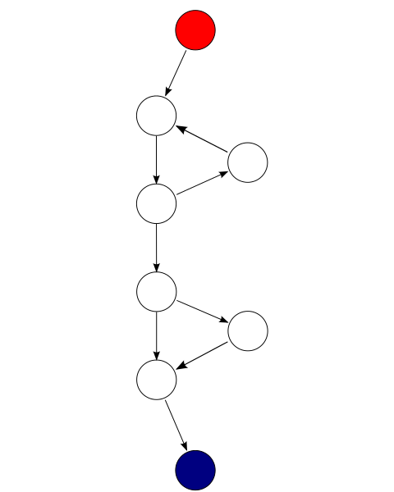
Cyclomatic Complexity
McCabe (1976)
func() {
while (cond1)
action1;
if (cond2)
action2;
action3;
return;
}

Slide 16
Cyclomatic Complexity
E = the number of edges of the graph.
N = the number of nodes of the graph.
P = the number of connected components
M = E − N + 2P
M = 9 – 8 + 2*1 = 3

Slide 17
Cyclomatic Complexity
For methods, P is always 1 ->
M = E − N + 2
But what does it mean!
Number of independent paths
# of branch tests <= M < = # of paths
For structured programs, M = number of decision points + 1
Beware! if (0 < x && x < 10) have extra decision points!

Slide 18
Cyclomatic Complexity
What's the use?
Use it as an indicator of how complex the method is
What is a good limit for a method?
10-25 – depending how good you and your process are
What to do?
Reorganize your code
Refactor: into subfunctions and classes
In a structured way!
Then run your tests!

Slide 19
Cyclomatic Complexity
Use it for a test check:
line coverage >= 100% ☺
# of test cases >= M
support with Boundary Value Analysis
And ZOMBIE

Slide 20
Halstead Complexity
Halstead, 1977
http://en.wikipedia.org/wiki/Halstead_complexity_measures

Slide 21
Visual Studio Code Metrics
Lines of code
Class Coupling
Depth of Inheritance
Cyclomatic Complexity
Maintainability Index
M = 171 - 5.2 * ln(Halstead Volume) - 0.23 * (Cyclomatic Complexity) - 16.2 * ln(Lines of Code)
MAX(0, M * 100 /171) (Rebase to 0-100 scale)
(ln = natural logarithm, base e)
Demo of VS

Slide 22
See for yourself
Use one of your solutions to look at Visual Studio Code Metrics
Just look at the class libraries, not the applications

Slide 23
Warning!
It ain't that easy!
How to interpret numbers?
Are they based on sound theory and science?
Like national school tests – if you aim for good numbers for a particular measurement, you may fail somewhere else!
Like VW!

Slide 24
Qualitative code analysis
Enforce a code style and discipline
Detect possible errors

Slide 25
lint
The original qualitative static analysis tool was lint – ”fnug/fnuller”.
List of tools for .NET, including C#
Newer tools:
.Net Code Analysis
Resharper
SonarQube

Slide 26
Code analysis for style
Company police to enforce company policy
Code style:
Formatting
Member data and method name rules
Rules of thumb
e.g. the destructor should always be virtual (C++)
Framework Specifics
Portability

Slide 27
Code Analysis for Errors
Uninitialized variables
Wild pointers
Missing deletes
double deletes
Other problems, depending on the scope of the analysis

Slide 28
Code Analysis for Errors - Cons
False positives
Configuration is complicated and enormous
How to filter to a decent level of warnings?
Takes time – like a slow compilation
Therefore: push it to the CI server

Slide 29
Tools for Code Analysis
The Compiler
Code Analysis in VS – is still a mess (2021)!
From .NET 5 analyzers included in SDK, no need for separate install
Before .NET 5 (e.g. .NET Core 3.1) use per-project NuGet package install of Microsoft.CodeAnalysis.NetAnalyzers
Code analysis can be configured in .editorconfig file.
Remember to copy a template to solution root. E.g.: %userprofile%\.nuget\packages\microsoft.codeanalysis.netanalyzers\5.0.3\editorconfig\AllRulesEnabled /.editorconfig
If .editorconfig is not copied explicitly defaults can’t be trusted
ReSharper
... and many others
Demo of Visual Studio

